Slide 3
Neutral funcional shirts
Model
Colour

Slide 4
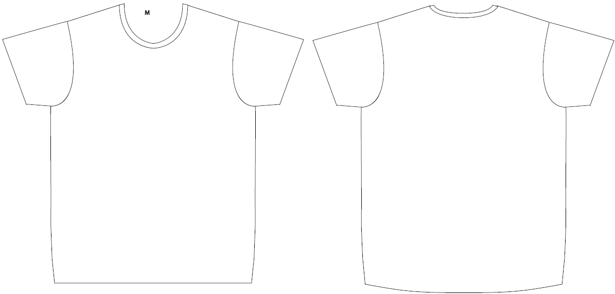
Layout for print – basic shirt white

Slide 5
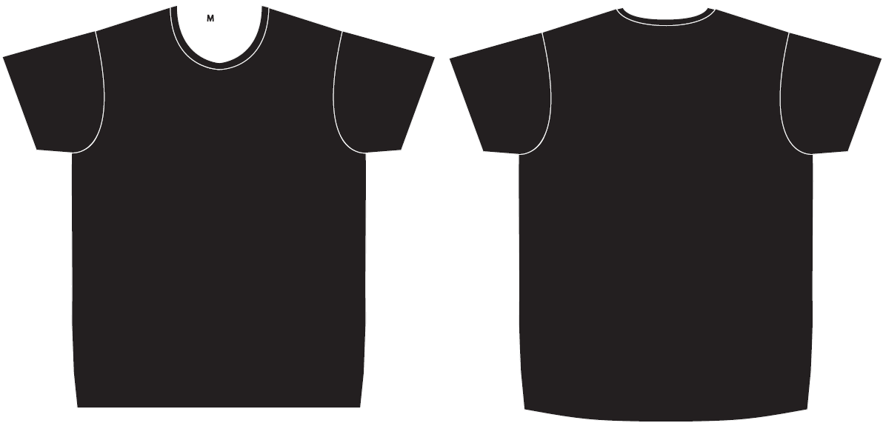
Layout for print – basic shirt black

Slide 6
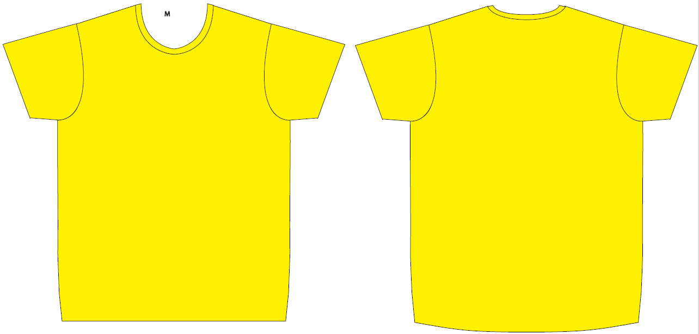
Layout for print – basic shirt yellow

Slide 7
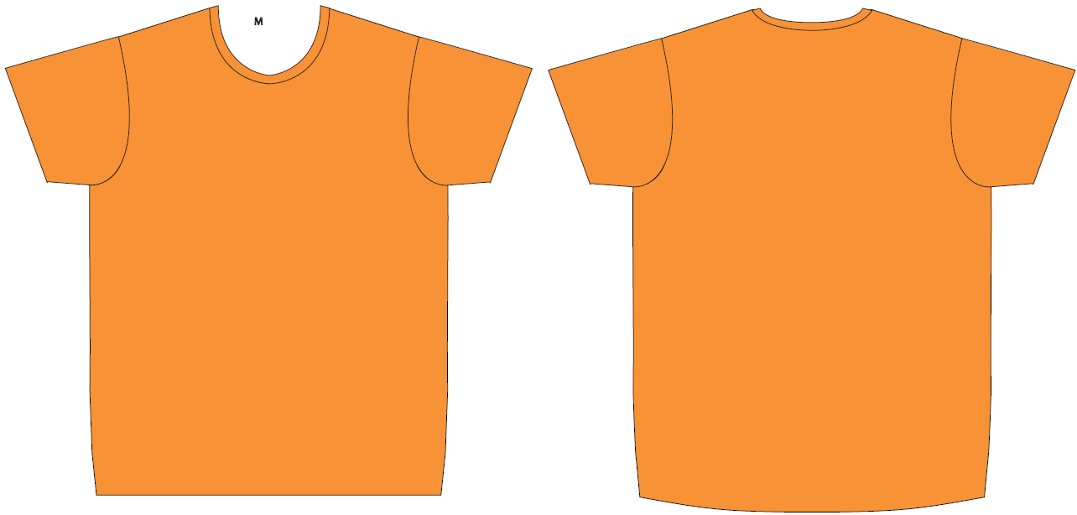
Layout for print – basic Shirt neon orange

Slide 8
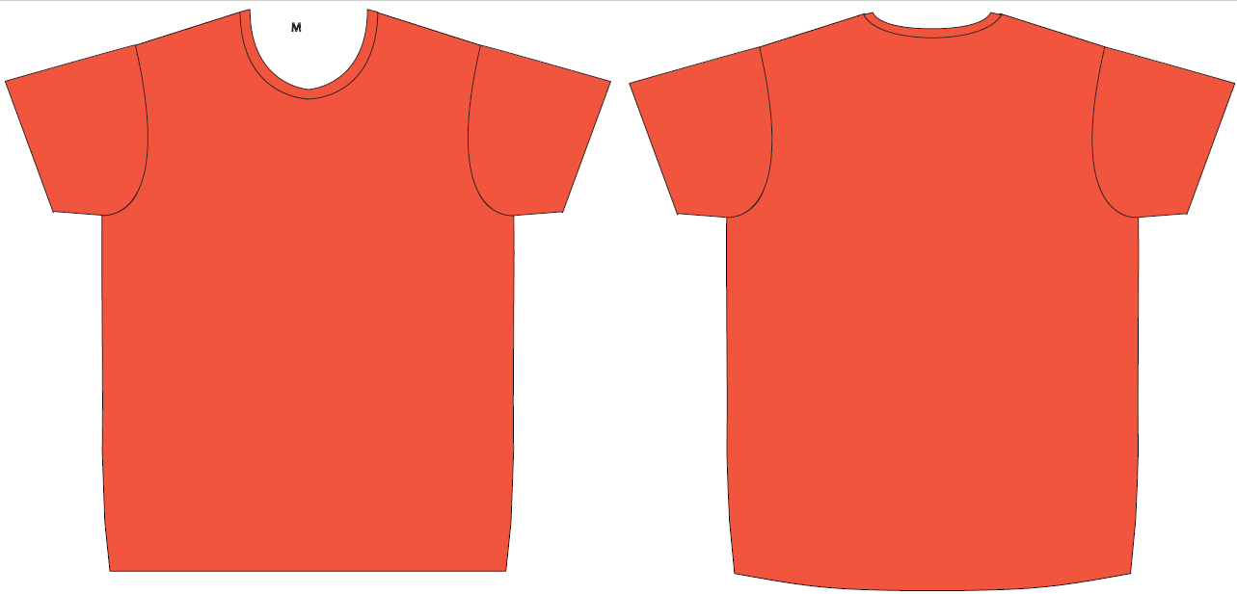
Layout for print – basic shirt blood orange

Slide 9
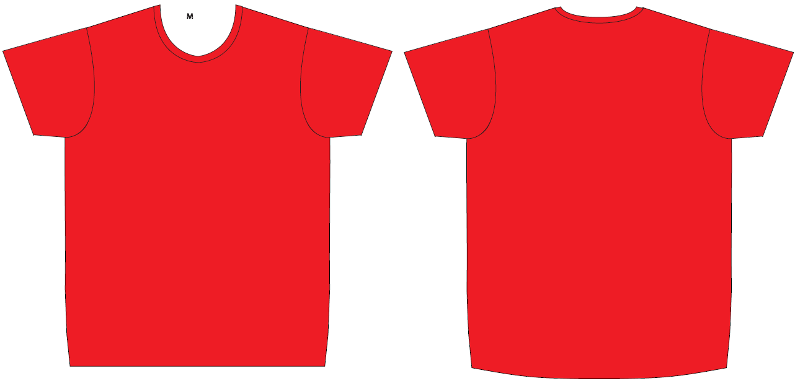
Layout for print – basic Shirt red

Slide 10
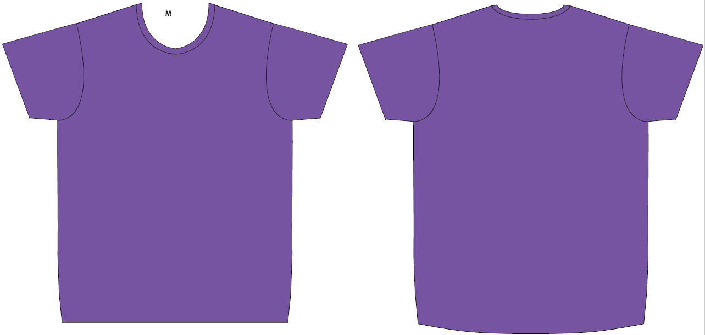
Layout for print – basic shirt purple

Slide 11
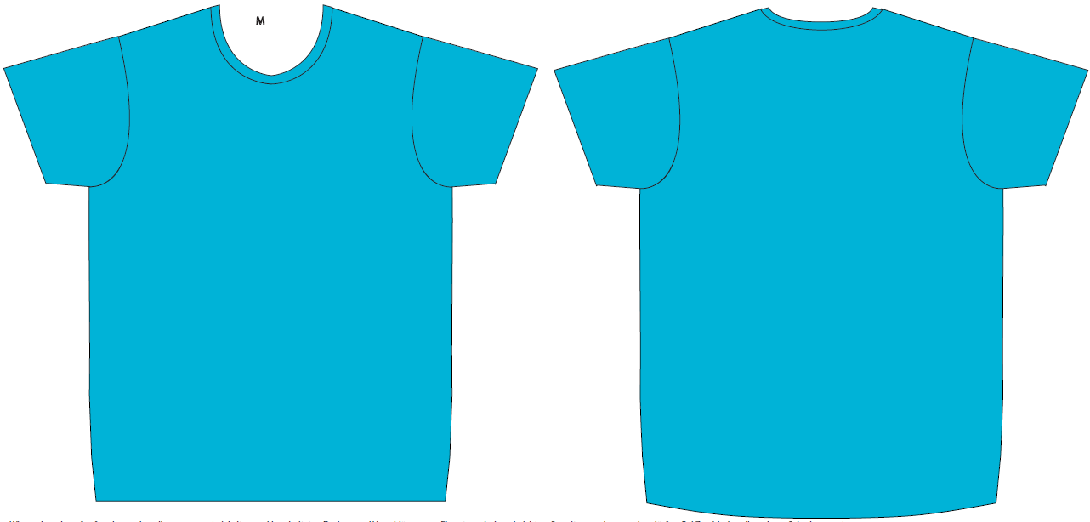
Layout for print – basic shirt light blue

Slide 12
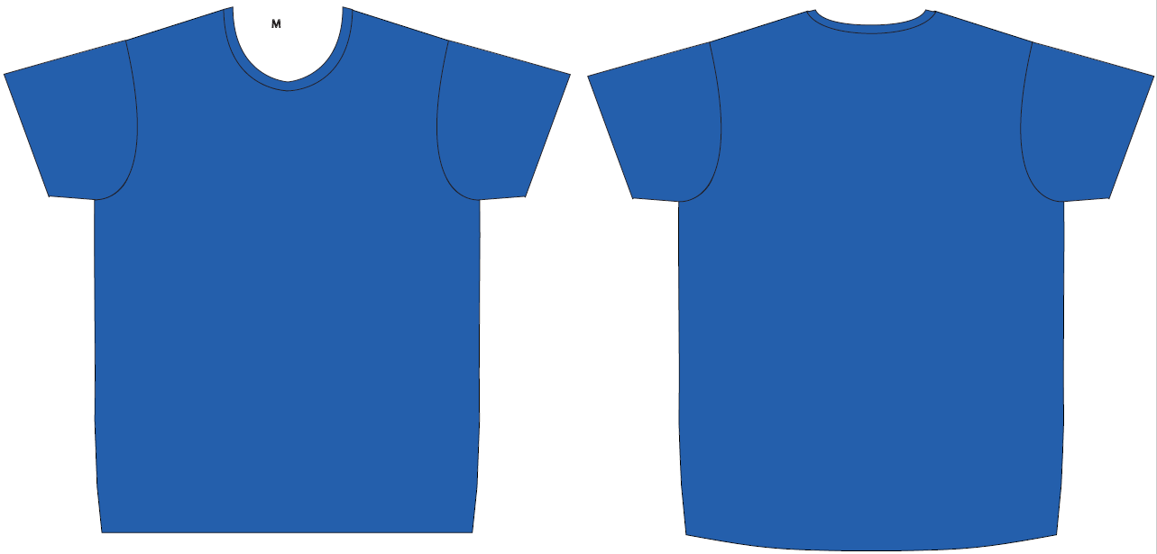
Layout for print – basic shirt royal blue

Slide 13
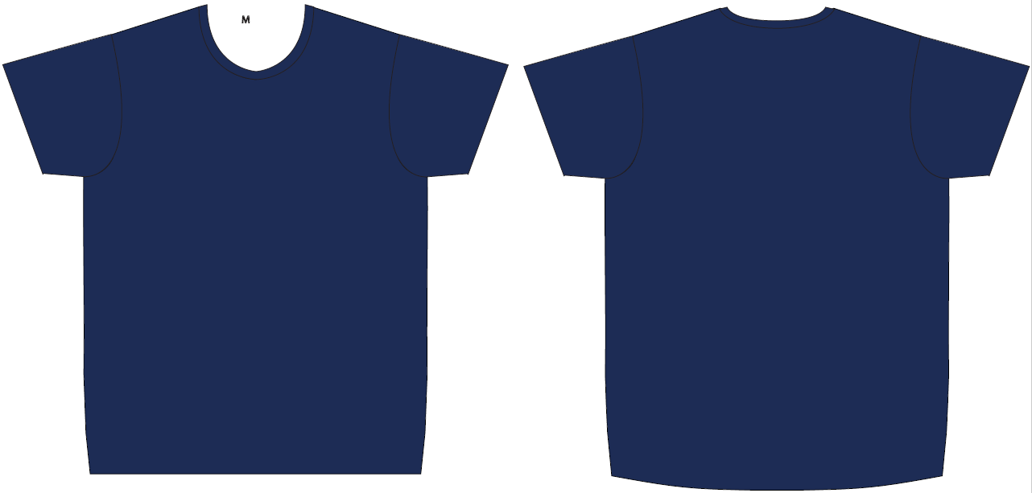
Layout for print – basic shirt navy blue

Slide 14
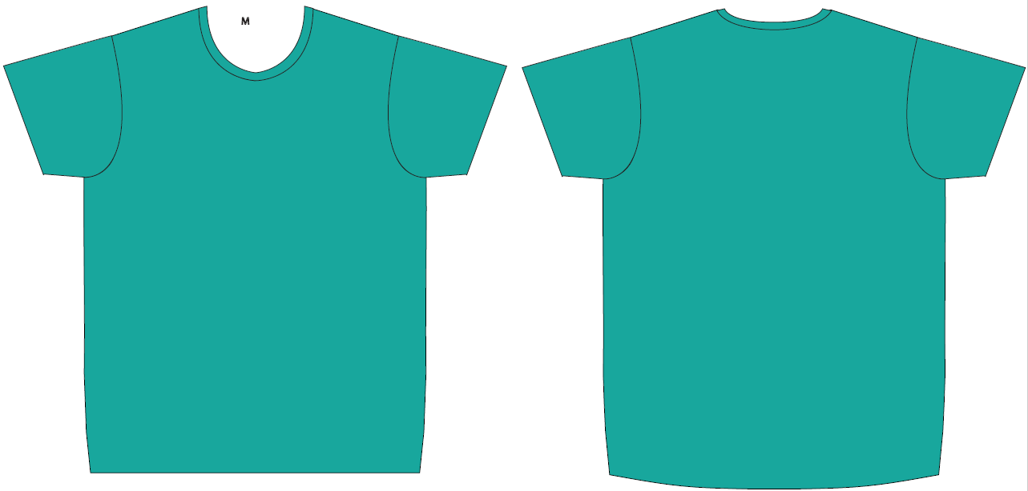
Layout for print– basic shirt turquoise

Slide 15
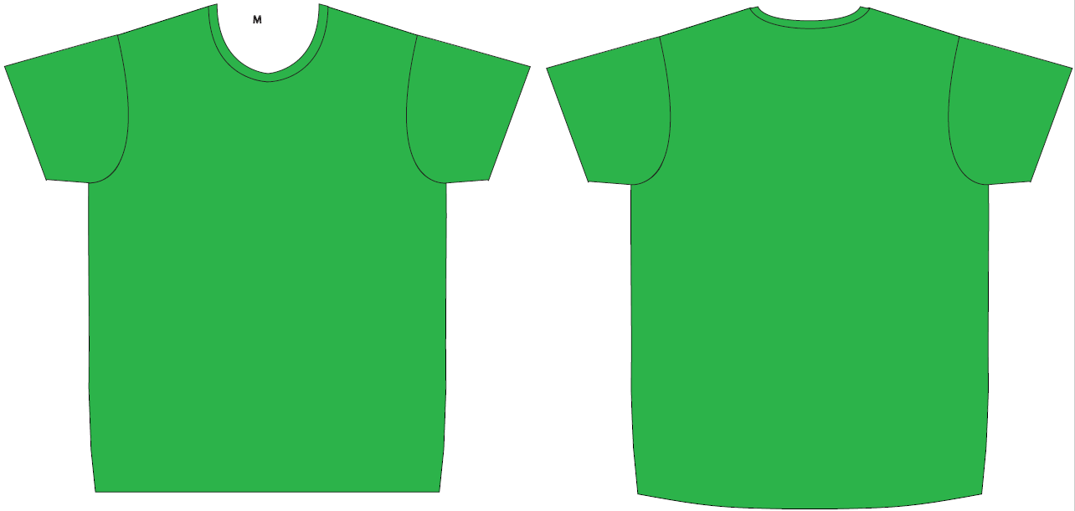
Layout for print – basic shirt neon green

Slide 16
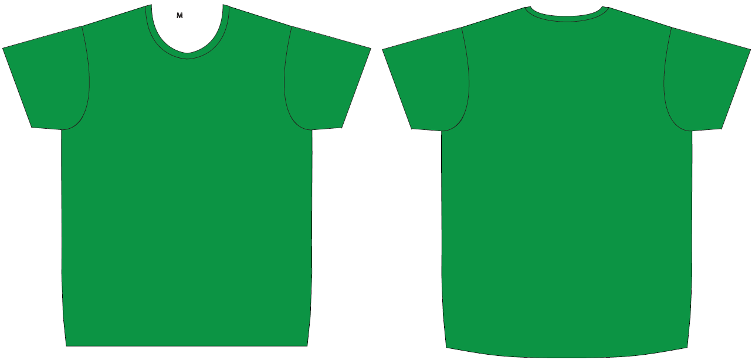
Layout for print – basic shirt may green

Slide 17
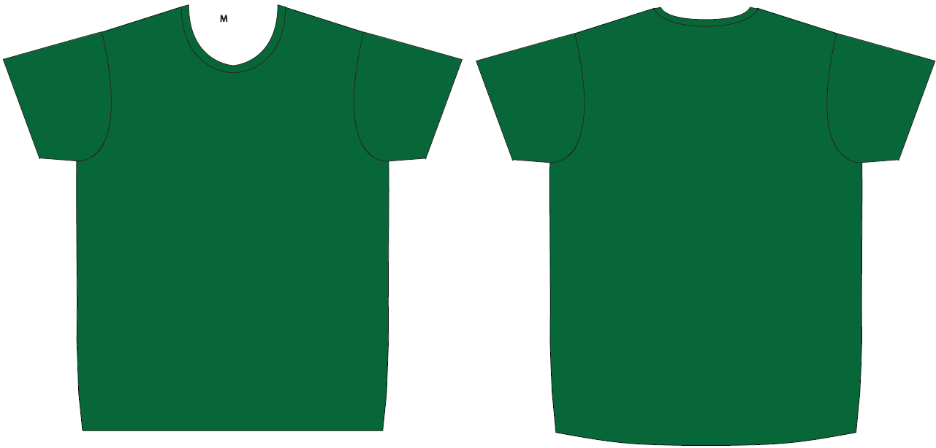
Layout for print – basic shirt Bottle green

Slide 18
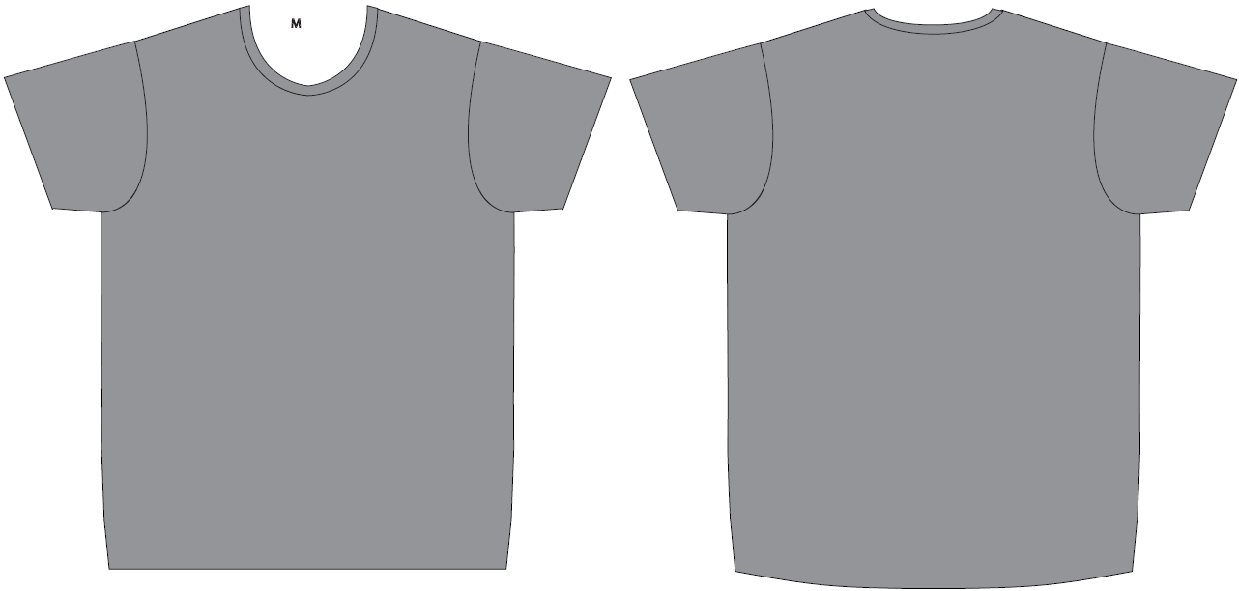
Layout for print – basic shirt light grey

Slide 19
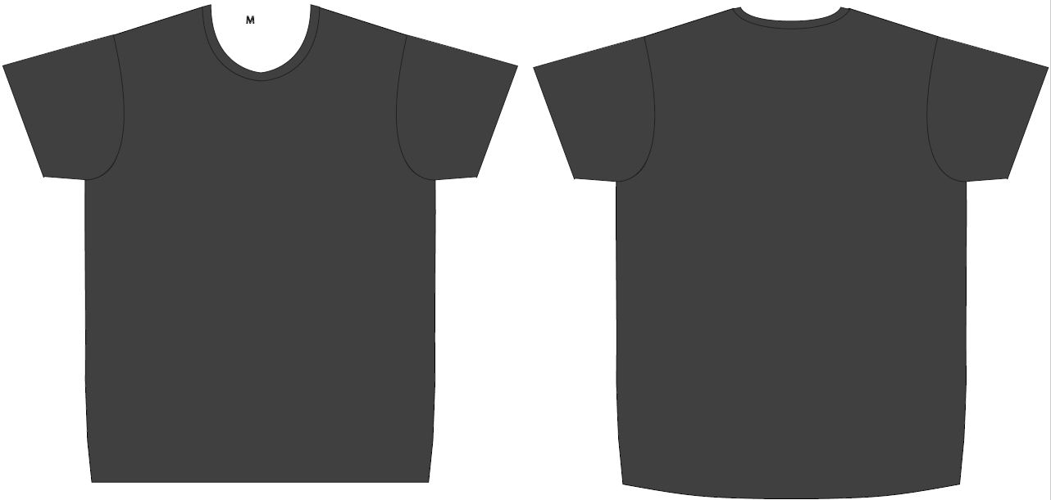
Layout for print – basic shirt anthracite

Slide 20
Sizes
Women
Men
Size | Amount
XS
S
M
L
XL
Size | Amount
S
M
L
XL
XXL

Slide 21
Details
Company
Contact
Email
Phone
Delivery address
At which event/s do you participate?
Did you already order shirts last year and want the same design? → Please specify the model
Only for B2Run: Would you like a delivery to the company or directly to the run? → Delivery to the company only possible if ordered 6 weeks before the event For delivery in company the shipping costs will be added
Comments

