Slide 3
Neutral funcional shirts
Model
Colour

Slide 4
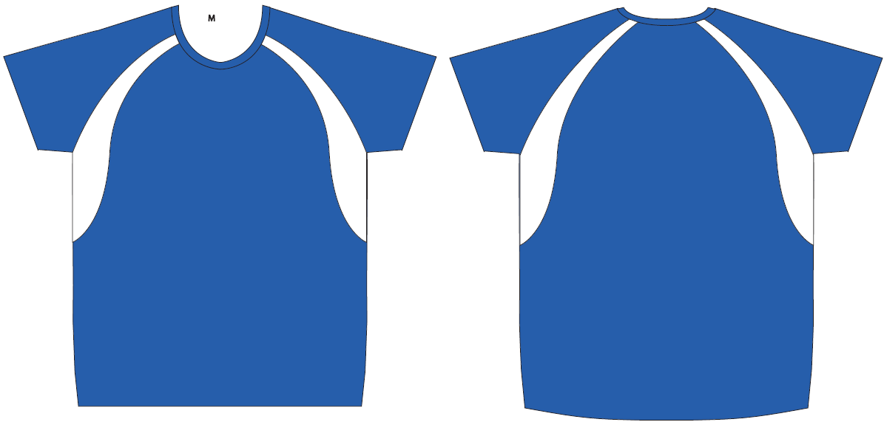
Layout For print – raglan one blue-white

Slide 5
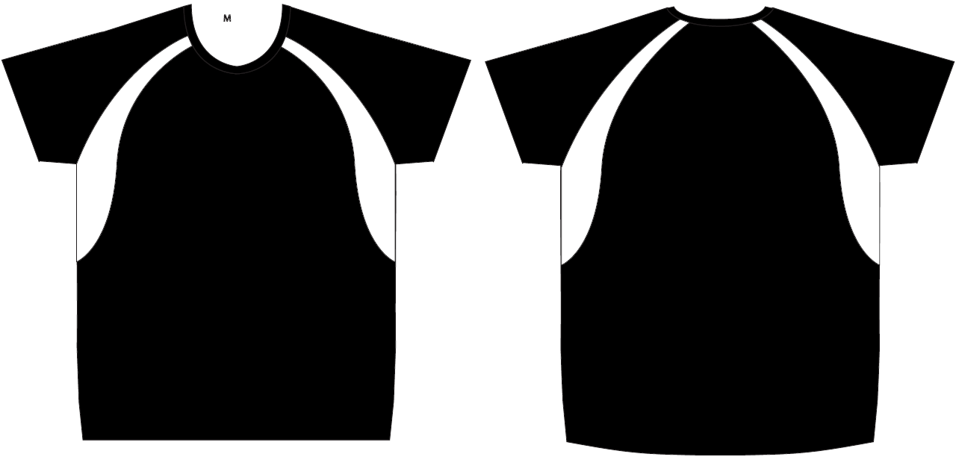
Layout For print – Raglan one black-white

Slide 6
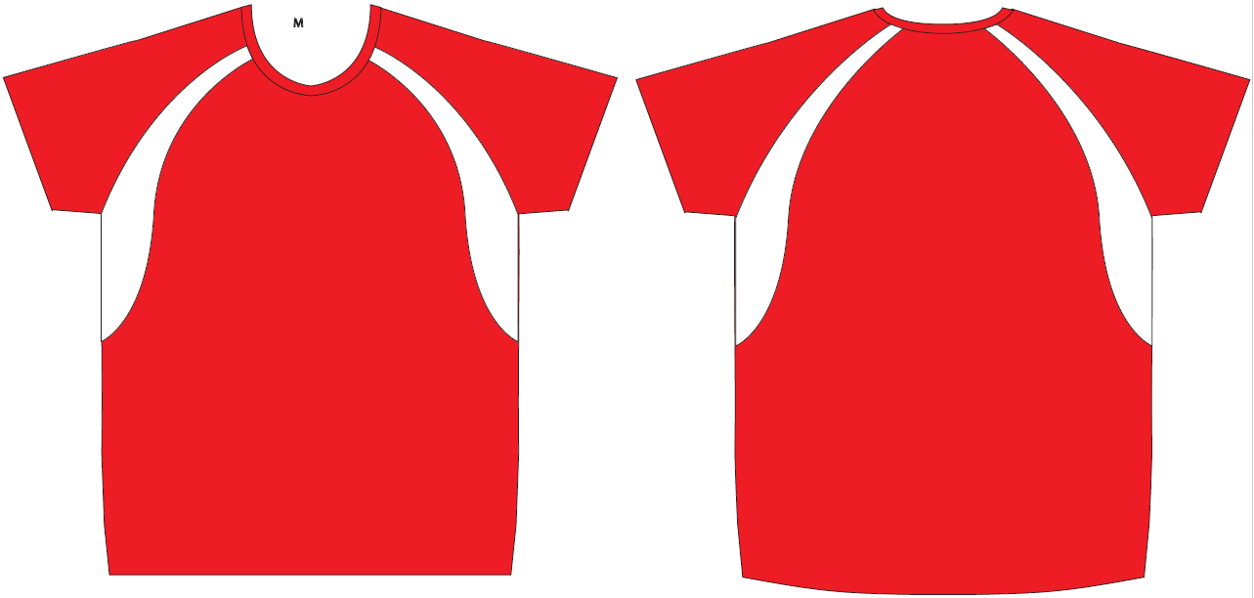
Layout For print – Raglan one red-white

Slide 7
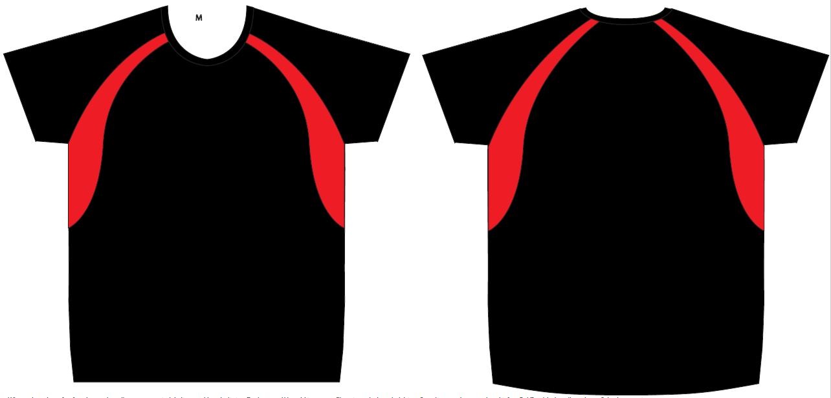
Layout For print – Raglan one black-red

Slide 8
Sizes
Women
Men
Size | Amount
XS
S
M
L
XL
Size | Amount
S
M
L
XL
XXL

Slide 9
Details
Company
Contact
Email
Phone
Delivery address
At which event/s do you participate?
Did you already order shirts last year and want the same design? → Please specify the model
Only for B2Run: Would you like a delivery to the company or directly to the run? → Delivery to the company only possible if ordered 6 weeks before the event For delivery in company the shipping costs will be added
Comments

