Slide 3
Neutral funcional shirts
Model
Colour

Slide 4
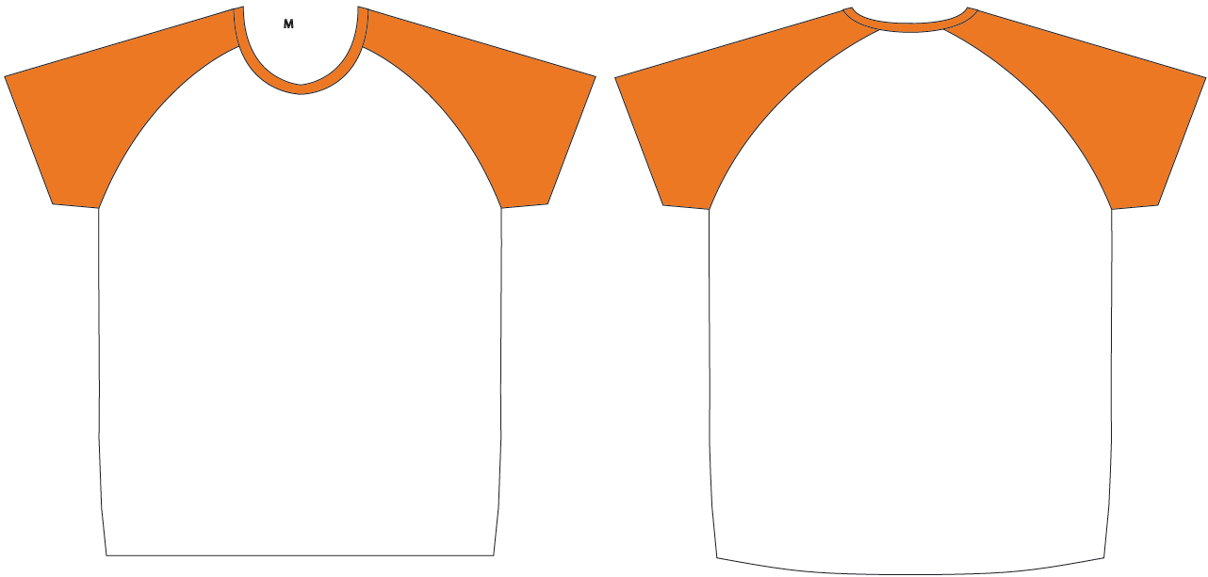
Layout for print – raglan sleeve white-orange

Slide 5
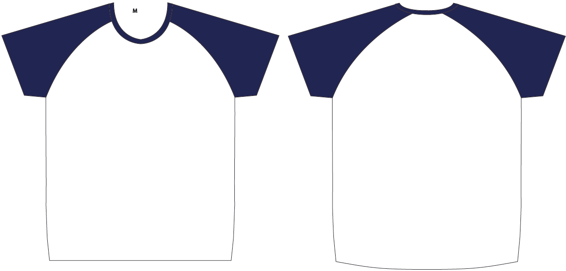
Layout for print –
Raglan sleeve white-navy

Slide 6
Sizes
Women
Men
Size | Amount
XS
S
M
L
XL
Size | Amount
S
M
L
XL
XXL

Slide 7
Details
Company
Contact
Email
Phone
Delivery address
At which event/s do you participate?
Did you already order shirts last year and want the same design? → Please specify the model
Only for B2Run: Would you like a delivery to the company or directly to the run? → Delivery to the company only possible if ordered 6 weeks before the event For delivery in company the shipping costs will be added
Comments

