Slide 3
Neutral funcional shirts
Model
Colour

Slide 4
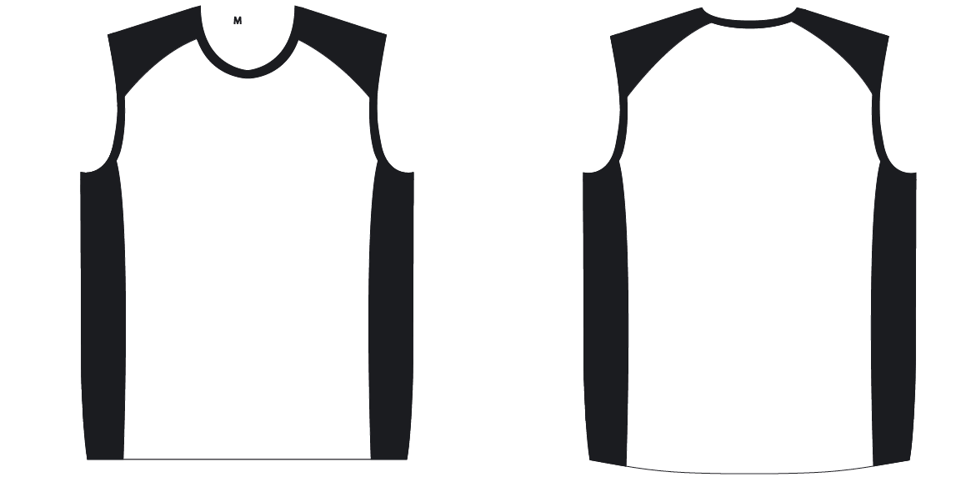
Layout For print – Singlet white-black

Slide 5
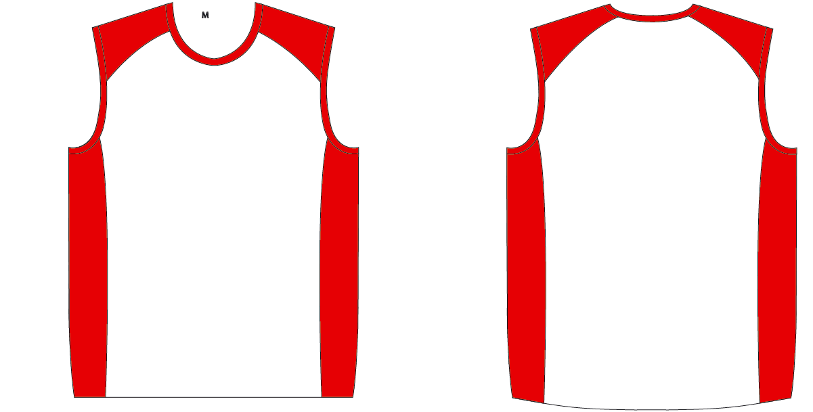
Layout For print – Singlet white-red

Slide 6
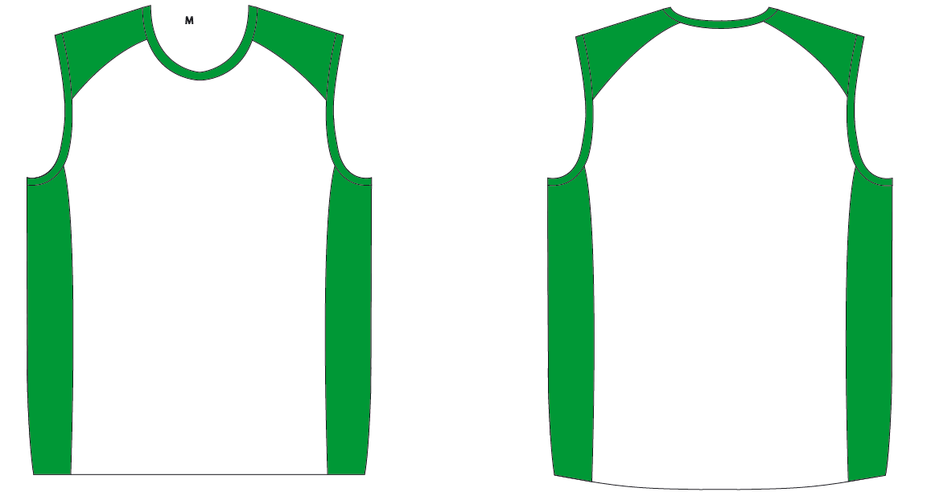
Layout For print – Singlet white-green

Slide 7
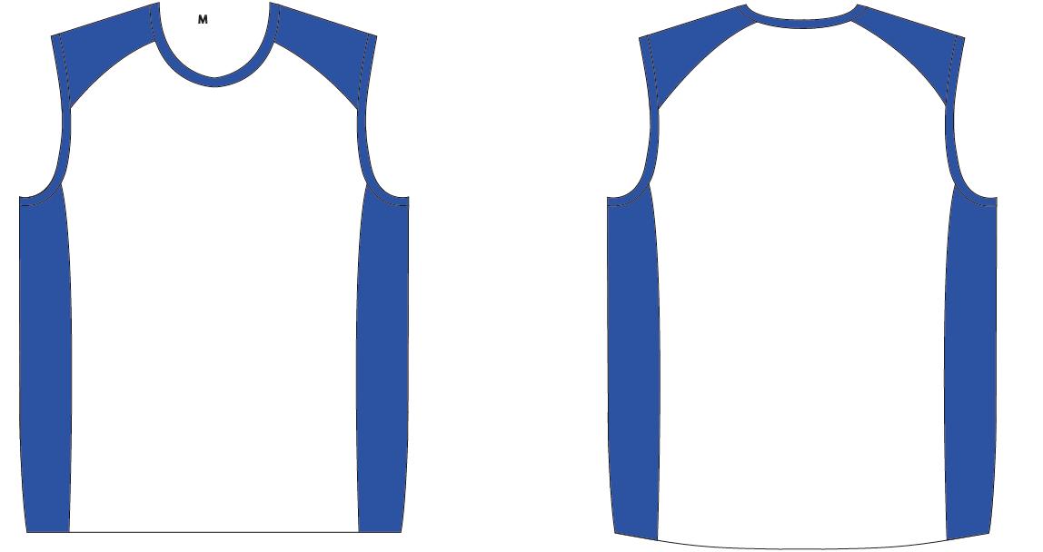
Layout For print – Singlet white-blue

Slide 8
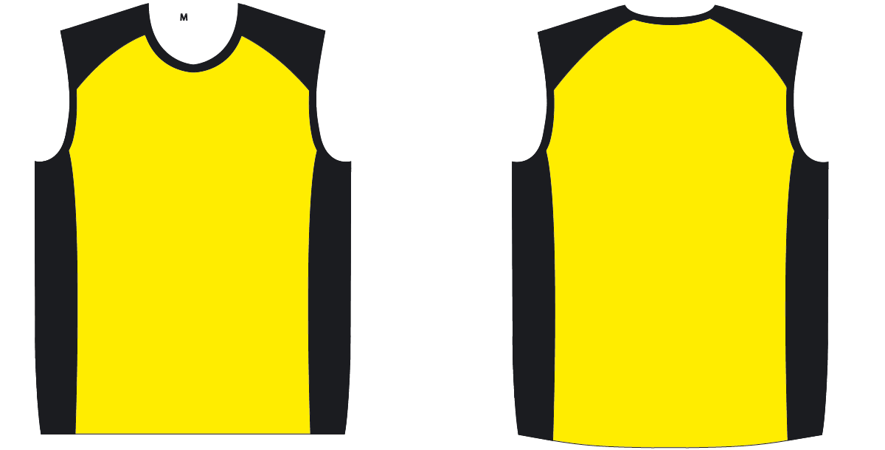
Layout For print – Singlet yellow-black

Slide 9
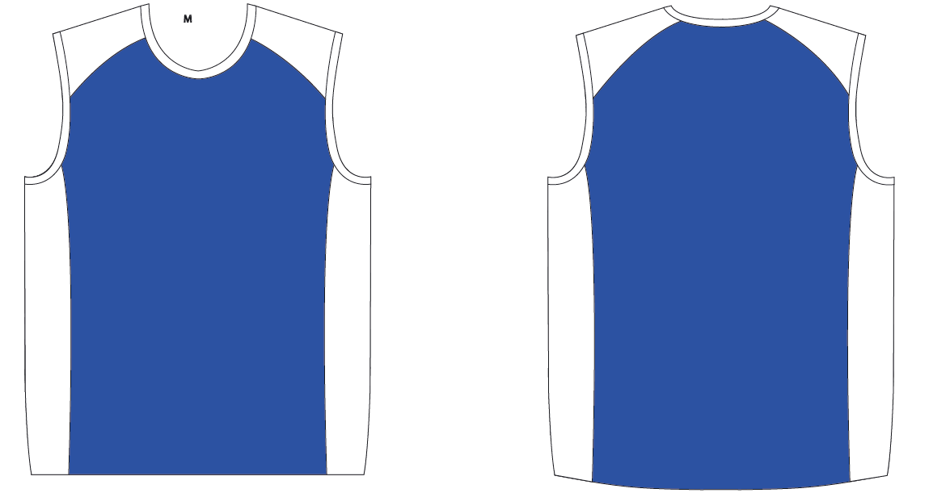
Layout For print – Singlet blue-white

Slide 10
Sizes
Women
Men
Size | Amount
XS
S
M
L
XL
Size | Amount
S
M
L
XL
XXL

Slide 11
Details
Company
Contact
Email
Phone
Delivery address
At which B2Run do you participate or which is your 1st run?
Did you already order shirts last year and want the same design? → Please specify the model
Only for B2Run: Would you like a delivery to the company or directly to the run? → Delivery to the company only possible if ordered 6 weeks before the event For delivery in company the shipping costs will be added
Comments

